Slide 1
Is it time to invest in our public transportation system?
A look into how Nashville compares with its peers.
Notes:
My capstone project is on the public transportation system and how Nashville compares with its peers.

Slide 2
Data Sources and Tools Used
Census Data: “City and Town Population Totals: 2010-2019”
https://www.census.gov/data/datasets/time-series/demo/popest/2010s-total-cities-and-towns.html
Public Transportation Ridership: “Monthly Module Raw Data Release”
https://www.transit.dot.gov/ntd/data-product/monthly-module-raw-data-release
Public Transportation Operating Costs/Fare Revenues: “Metrics_Static.xlsx”
https://www.transit.dot.gov/ntd/data-product/2019-data-tables
Tools:
Python
Tableau
Excel
Notes:
Here are some of my data sources. Population data from the Census and public transportation data was from the Department of Transportation.
The majority of my work was done in Python as that was my favorite technology I learned during this course. I will have a small dashboard created in Tableau. And finally I used excel to verify data and confirm things were lined up correctly.
I want to note that I wanted to include SQL in my project but ultimately ran out of time.

Slide 3
Goals
To evaluate if Nashville needs to invest more into public transportation.
Compare Nashville to some of its peers.
A view into what Nashville could look like in the future.
Share my finds with the general public to sway their opinion on public transportation.

Slide 4
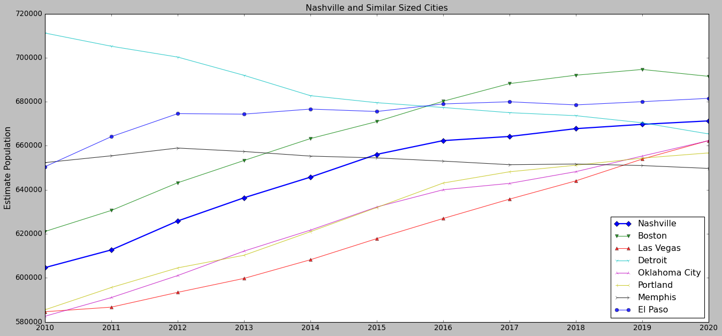
Similar Sized Cities to Nashville
Notes:
On this slide, we are taking a look at Nashville’s population growth over the last decade. Represented by the blue line with the diamond markers. This data was pulled from the Census.
I then took Nashville’s population in 2020 and plotted some cities with similar sized populations. The range I chose was +- 5% Nashville’s population.
This range was arbitrarily chosen but it gave me a good number of neighboring cities.
One thing to note is some of the trajectories of these cities. While the majority are on an upward trend, cities such as Detroit and Memphis are going in the opposite direction.
Before we take a look at the cities public transportation, I want to notate a couple of benefits from public transportation.

Slide 5
Benefits of public transportation
Reduces air pollution
Increases mobility
Encourages healthier habits
Reduced traffic congestion
Notes:
These are only some of the benefits that you would get with public transportation.
Air pollution - We all remember COVID lockdown and you could notice the better air quality due to less cars.
Mobility - As the city grows, places to live get more scarce. We need to invest in public transportation to increase that mobility.
Healthier habits - having a good network of public transportation encourages more people to walk and stay active
Reduced traffic congestion - As we walk through the next couple of slides, keep this one in mind.

Slide 6
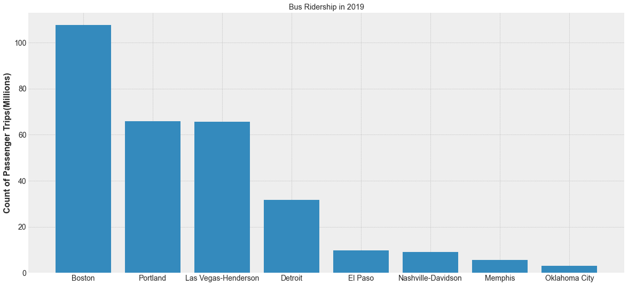
Looking at the most common mode of public transportation.
Notes:
The data in the next couple of slides were pulled from the Department of Transportation and they will cover the ridership numbers and finances. The dataset included data dated back to 2001. I selected the ridership numbers from 2019 because that is the most recent set before the Pandemic.
So the first mode of transportation I wanted to look at was buses. They are the most simple and most common across all cities, so I wanted to compare their ridership numbers.
As you can see, Nashville’s ridership is not too high. These cities all have relatively the same population yet some have 5-10x more bus riders. There is room for Nashville to catch up to some of these cities.
I then wanted to see what everyone’s overall ridership looked like.

Slide 7
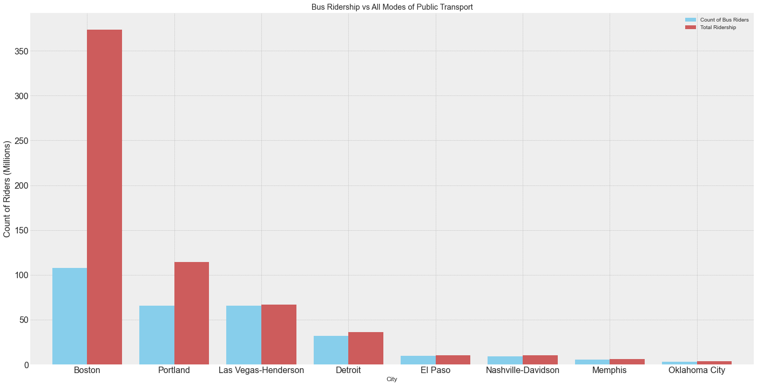
Bus Ridership vs Overall
Notes:
On this graph, I’ve plotted the ridership across all modes of public transportation, including buses. This is represented by the red bar.
I have also included how much of it is from buses, which is in blue.
Please note that the majority of public transportation is made up of buses.
It is interesting to see Boston’s numbers. Only about 30% of their ridership is attributed to buses. The majority of it looks to be something else, and I wanted to check what it was.

Slide 8
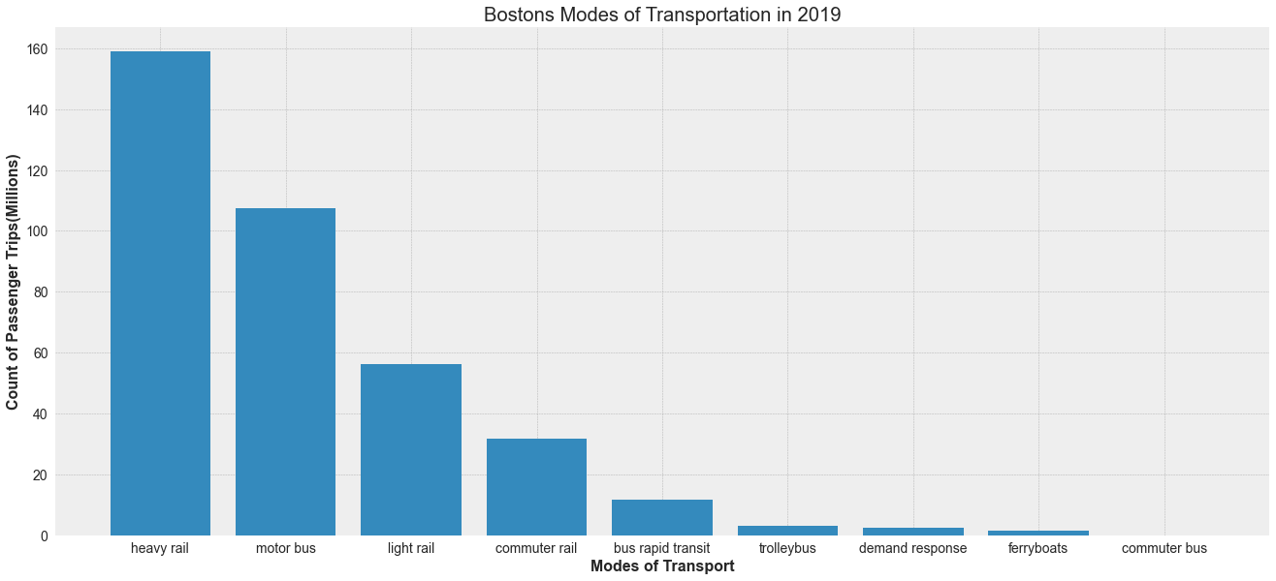
Boston’s Modes of Transportation
Notes:
So this is a breakdown of Boston’s modes of transportation. You can see that the bus is ranked 2nd in ridership.
But the majority of Boston’s ridership is on some kind of rail system. Ultimately, I would like Nashville to head in this direction as we grow.
Rail systems are efficient, just imagine a train compared to a bus. Trains have the capacity to move hundreds of people while buses are at most able to move 30-40.
The major obstacle to these nice rail systems are the costs.

Slide 9
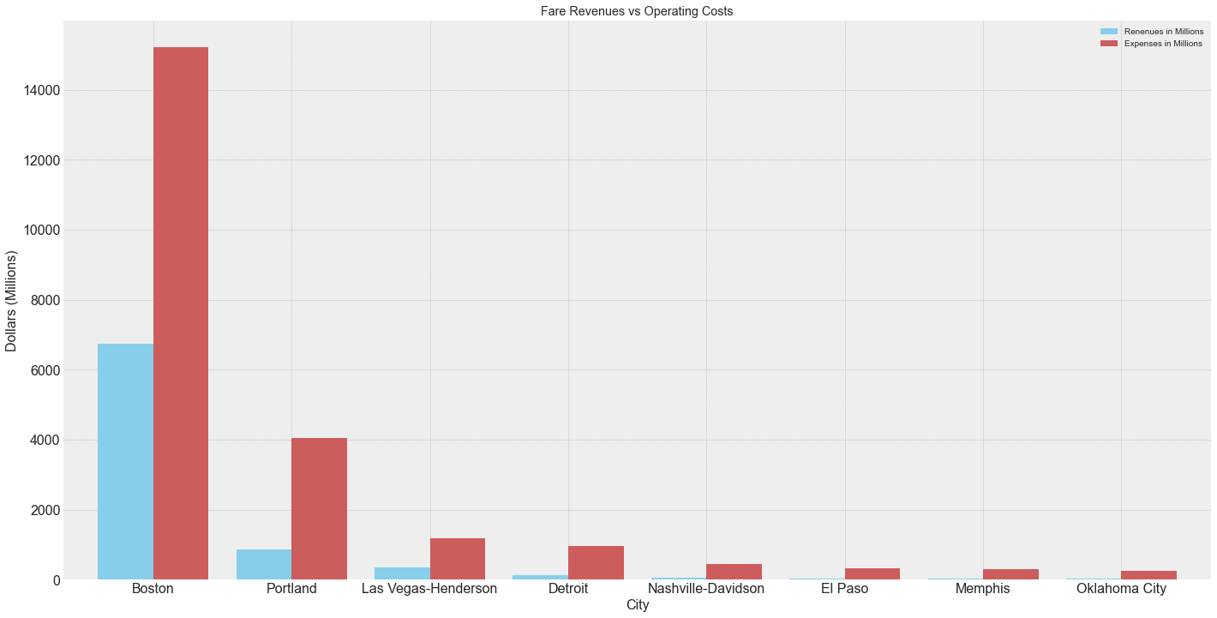
Revenue and Cost Breakdown
Notes:
This is a breakdown of the total operating expenses(shaded in orange) and the fare revenues(shaded in blue).
The operating expense is much much higher in the cities that have rail systems, but we need to change our viewpoint.
These expenses need to be viewed as an investment back into these respective cities. The are investing this money into the public transportation system in order to get those benefits we list earlier.
Now the next couple of slides are a look into the future.

Slide 10
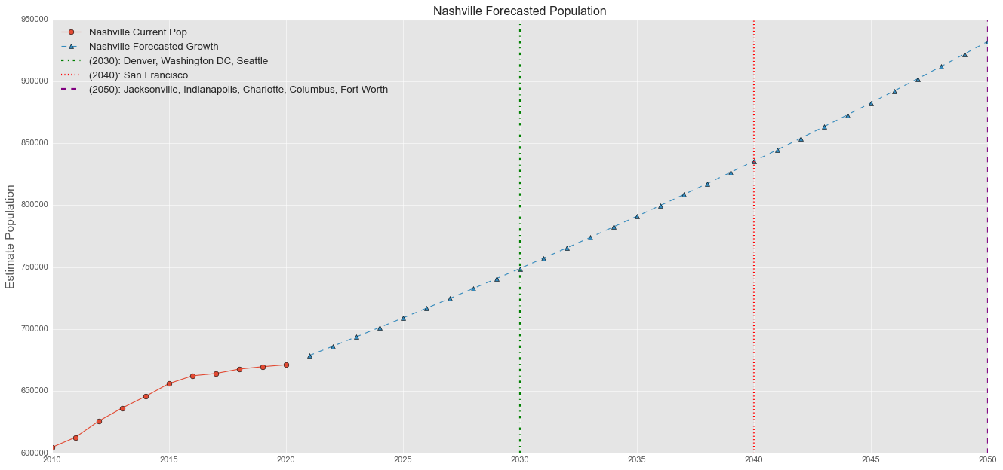
Nashville’s Forecasted Growth
Notes:
This is another population graph.
In this graph, I have taken Nashville’s growth over the last decade. I’ve calculated the percent growth which was about 1% average a year. Then I applied that 1% over the next 30 years.
I’ve placed markers at each decade, and if you look at the legend in the top left hand corner, I’ve listed cities that currently have that population.
So by 2030, Nashville will be as large as Denver, Washington DC, and Seattle.

Slide 11
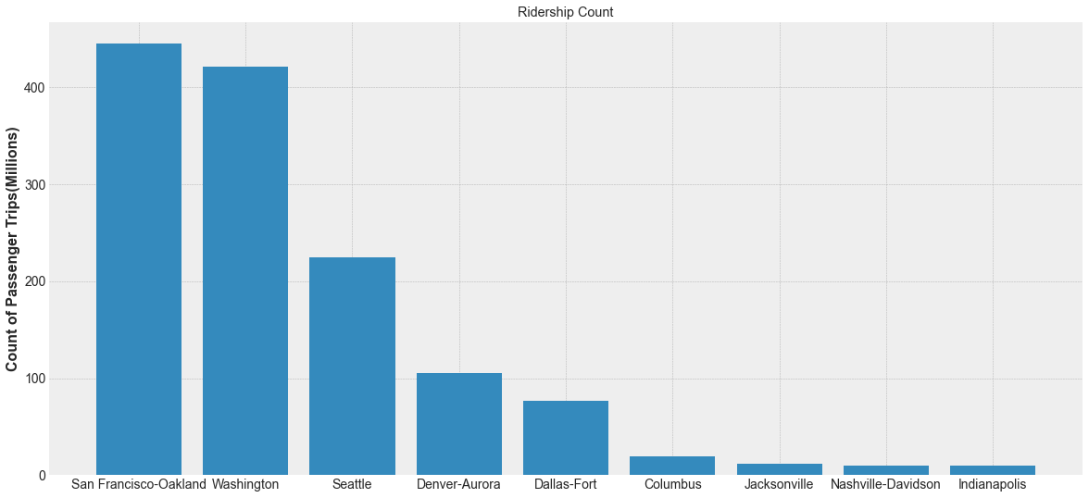
Future Ridership
Notes:
As your population grows, your need for more public transportation increases.

Slide 12
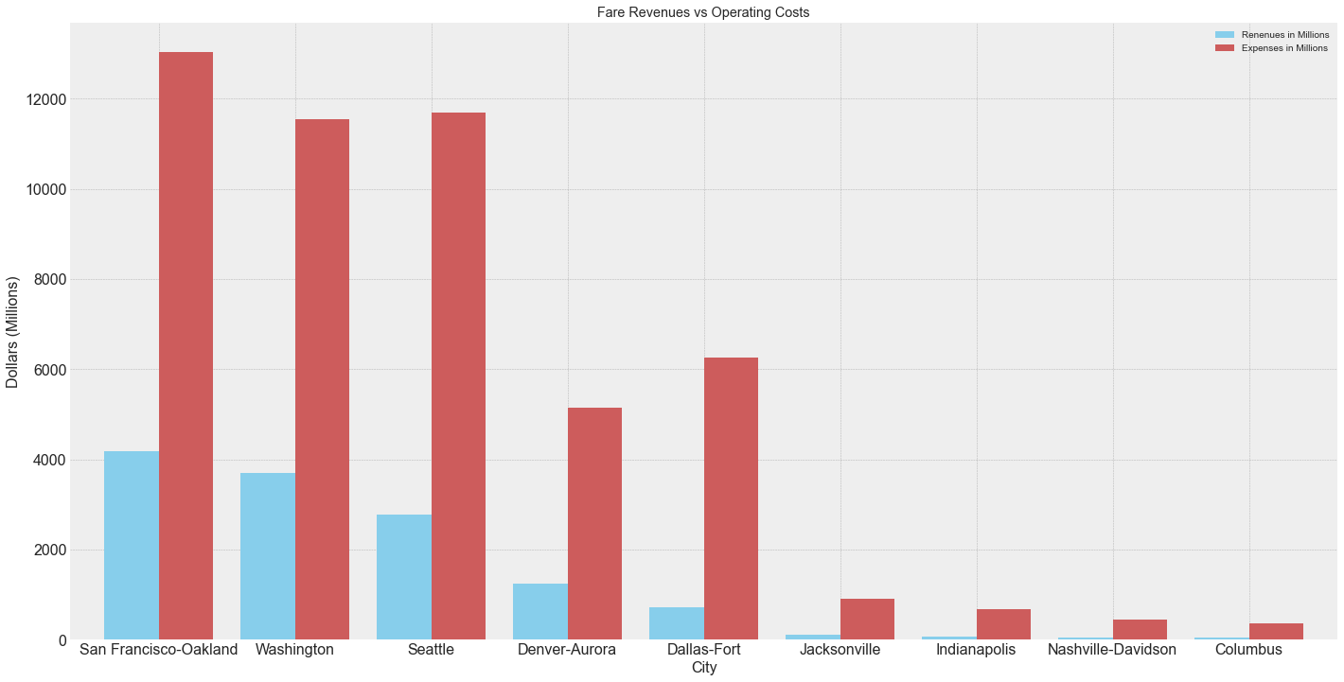
Future Revenue and Expenses
Notes:
This graph, the cities at the bottom are ordered the same way as the previous graph.
One interesting thing to note here, is that Dallas spends more on their public transportation but has a lower ridership.
Seattle also spends a little more than DC but Seattle’s ridership is much lower.

Slide 13
Challenges during the project
Sourcing the right data.
Cleaning the data so that the visualizations will contain the important information.
Joining data from different sources.
Picking the right visuals so that the audience is able to follow the story.
Notes:
-The internet is full data. Some is useful while others are not so much. It takes a good amount of time to pick out datasets.
-Cleaning up the data to extract information was also difficult and time consuming. Data from different sources are structured differently. In order to make visualizations for you data, I needed to filter and slice the data so that it can be plotted.
-I needed to join datasets together from different sources and the columns needed to be clean to join.
-Picking the right visuals from the many, many options, and be able to tell a story from those visuals. I will admit that visualizations was not a strong for me during this class, and that’s why I chose simple graphs for my presentation.
Finally, my last slide is within Tableau.

Slide 14
Tableau Dashboard
https://public.tableau.com/app/profile/teng.ye/viz/Public_Transportation_Ridership/PublicTransportationStory

